Slide 1
HTML TAGS
MCNDHS
Ms. Eng

Slide 2
AIM: HOW DO WE CREATE A FIELD SET?
Do now:
Daily Grade:
On-time/attendance/not leaving the classroom: 25%
Cellphones: 25%
Notes:25%
Classwork/Homework: 25%

Slide 3
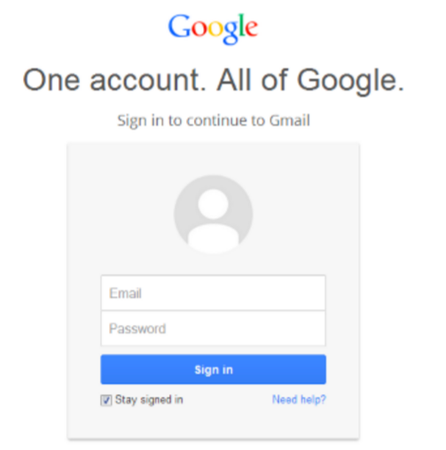

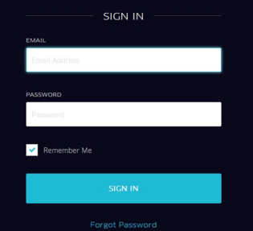
WHAT ARE WE LEARNING TODAY?

Slide 4
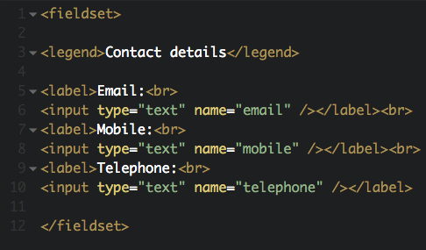
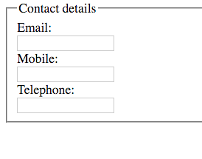
FIELDSET

Slide 5
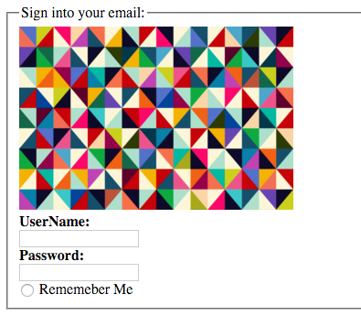
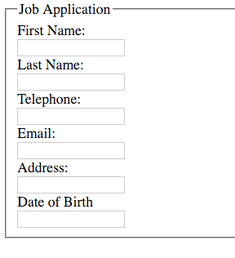
ACTIVITY

